Slide 1

SRM INSTITUTE OF SCIENCE AND TECHNOLOGY COLLEGE OF ENGINEERING AND TECHNOLOGY
DEPARTMENT OF NETWORKING AND COMMUNICATIONS 18CSP107L - MINOR PROJECT
CYBER HACKING BREACHES PREDICTION USING MACHINE LEARNING
Student 1 Reg No: B NAGASAI ASHISH VARMA UPPALA (RA2011030010039)
Student 2 Reg No: AARIKATLA THARUN KUMAR(RA2011030010033)
Batch ID:
Guide name and Designation: DR.B.YAMINI (ASSISTANT PROFESSOR)

Slide 2
Table of Contents
Abstract
Introduction
Literature Review
Challenges and limitations in existing system
Objective
Scope
UML diagrams
Architecture diagram
Module description
Result and discussion
References
2

Slide 3
ABSTRACT
Cyber-physical systems(cps) have made significant progress in many dynamic applications due to the integration between physical processes, computational resources, and communication capabilities. However, cyber-attacks are a major threat to these systems.
Unlike faults that occurs by accidents cyber-physical systems, cyber-attacks occur intelligently and stealthy. Some of these attacks which are called deception attacks, inject false data from sensors or controllers, and also by compromising with some cyber components, corrupt data, or enter misinformation into the system.
If the system is unaware of the existence of these attacks, it won’t be able to detect them, and performance may be disrupted or disabled altogether. Therefore, it is necessary to adapt algorithms to identify these types of attacks in these systems.
It should be noted that the data generated in these systems is produced in very large number, with so much variety, and high speed, so it is important to use machine learning algorithms to facilitate the analysis and evaluation of data and to identify hidden patterns. In this research, the CPS is modeled as a network of agents that move in union with each other, and one agent is considered as a leader, and the other agents are commanded by the leader.

Slide 4
INTRODUCTION
Recent advances in technology have led to the introduction of cyber-physical systems, which due to their better computational and communicational ability and integration between physical and cyber-components, has led to significant advances in many dynamic applications.
But this improvement comes at the cost of being vulnerable to cyber-attacks. Cyber-physical systems are made up of logical elements and embedded computers, which communicate with communication channels such as the Internet of Things(IoT).
More specifically, these systems include digital or cyber components, analog components, physical devices and humans that designed to operate between physical and cyber parts. In other words, a cyber-physical system is any system that includes cyber and physical components and humans, and has the ability to trade between the physical and cyber parts.
In cyber-physical systems, the security of these types of systems becomes more important due to the addition of the physical part. Physical components including sensors, which receive data from the physical environment, maybe attacked and be injected incorrect data into the system.

Slide 5
MOTIVATION
Cybersecurity threats and hacking techniques are continuously evolving and becoming more sophisticated. Traditional security measures alone may not be sufficient to detect and prevent emerging threats. Machine learning offers the capability to adapt and learn from new data, enabling proactive defense against evolving cyber attacks.
Machine learning-based breach prediction allows organizations to adopt a proactive security approach rather than a reactive one. By identifying potential threats before they materialize into full-scale attacks, organizations can take pre-emptive measures to mitigate vulnerabilities, prevent data breaches, and minimize the potential impact on business operations.
In the digital age, organizations generate vast amounts of data from various sources, making it challenging for traditional security methods to process and analyze effectively. Machine learning algorithms excel at handling large datasets, enabling the detection of subtle patterns and anomalies that may indicate hacking attempts.

Slide 6
LITERATURE SURVEY
Sl.No. | Title | Author | Methodology/ Algorithms | Inference | Year
1. | S e c u r i t y analysis | Cheolhyeon, Weiyi Liu, Inseok Hwang. | The aim of this paper to find the so-called insecurity conditions under which the estimation system is insecure in the sense that there exist malicious attacks that can bypass the anomaly detector but still lead to unbounded estimation errors. Moreover, a specific algorithm is proposed for generating attacks with which the e s t i m a t i o n s y s t e m i s insecure. | Furthermore, for t h e i n s e c u r e system, a system protection scheme through which only a few (rather than all) communication channels require protection against false data injection attacks is proposed. | 2013
 | for cyber-
 | physical
 | systems
 | a g a i n s t
 | s t e a l t h y
 | deception
 | attacks.

Slide 7
LITERATURE SURVEY
Sl.No. | Title | Author | Methodology/ Algorithms | Inference | Year
2. | Design and | Pajic, Miroslav, | Recent years have witnessed a significant increase in the number of security-related incidents in control systems. These include high-profile a t t acks in a wide range of application domains, from attacks on critical infrastructure, as in the case of the Maroochy Water breach [1], and industrial systems (such as the StuxNet virus attack on an industrial supervisory control and data acquisition system [2], [3] and the German Steel Mill cyberattack [4], [5]), to attacks on modern vehicles [ 6 ]-[ 8 ] . Even high- assurance military systems were shown to be vulnerable to attacks, as illustrated in the highly publicized downing of the RQ-170 Sentinel U.S. drone [9]-[11]. | However, the complexity and heterogeneity of this next generation of safety- critical, networked, and e m b e d d e d c o n t r o l systems have challenged t h e e x i s t i n g d e s i g n m e t h o d s i n w h i c h s e c u r i t y i s u s u a l l y c o n s i d e r a s a n afterthought. | 2017
 | implementati | James Weimer,
 | on of attack- | Nicola Bezzo
 | r e s i l i e n t
 | cyberphysica
 | l systems:
 | With a focus
 | on a t t ack-
 | resilient state
 | estimators

Slide 8
LITERATURE SURVEY
Sl.No. | Title | Author | Methodology/ Algorithms | Inference | Year
3. | Consensus | Sheng, Long, | T h e s t u d y o f g r o u p behaviors for multirobot s y s t e m s i s t h e m a i n objective of the work. G r o u p c o o p e r a t i v e behavior signifies that individuals in the group share a common objective and action according to the interest of the whole group. | Group cooperation can b e e f f i c i e n t i f individuals in the group coordinate their actions well. Each individual can coordinate with other individuals in the group to facilitate group cooperative behavior in two ways, named local coordination and global coordination. | 2012
 | f o r m a t i o n | Ya-Jun Pan,
 | control for a | a n d X i a n g
 | c l a s s o f | Gong.
 | networked
 | m u l t i p l e
 | m o b i l e
 | r o b o t
 | systems.

Slide 9
LITERATURE SURVEY
Sl.No. | Title | Author | Methodology/ Algorithms | Inference | Year
4. | R e s i l i e n t | Zeng, Wente, | The proposed algorithm embeds a resilience mechanism that includes four phases (detection, mitigation, identification, and update), into the control process in a distributed manner. At each phase, every agent only uses local and one- hop neighbors' information to identify and isolate the misbehaving agents, and even compensate their effect on the system. We then extend the proposed algorithm to the leaderless consensus network by introducing and adding two recovery schemes (rollback and excitation recovery) into the current framework to guarantee the accurate convergence of the well-behaving agents in NCS. | The effectiveness of the proposed method i s d e m o n s t r a t e d through case studies i n m u l t i r o b o t formation control and w i r e l e s s s e n s o r networks. | 2014
 | d i s t r i b u t e d | and Mo-Yuen
 | control in the | Chow
 | presence of
 | misbehaving
 | a g e n t s i n
 | n e t w o r k e d
 | c o n t r o l
 | systems.

Slide 10
Challenges and limitations in existing system
Predicting cyber hacking breaches using machine learning presents several challenges. Firstly, the rapidly evolving nature of cyber threats makes it difficult to keep models up-to-date with emerging attack techniques and tactics. Additionally, acquiring high-quality labeled datasets for training these models can be challenging due to the sensitive nature of cybersecurity data and the limited availability of comprehensive breach data.
Secondly, the imbalanced nature of cybersecurity data can lead to biased models. Most of the time, normal network traffic significantly outweighs malicious activity, causing models to have a bias toward false negatives (missed breaches). Striking a balance between sensitivity and specificity is crucial.
In the existing system, implementation of machine learning algorithms is bit complex to build due to the lack of information about the data visualization. Mathematical calculations are used in existing system for SVM model building this may takes the lot of time and complexity. To overcome all this, we use machine learning packages available in the scikit-learn library.

Slide 11
OBJECTIVES
The primary goal of this project is to determine the Cyber hacking breaches whether there will be attack or not and to know this we have used the Support Vector ,
Decision Tree, Random forest and Cat Boost Classifier classification techniques.
In a dynamic cybersecurity landscape, hacking techniques and attack vectors are constantly evolving. Thus, an essential objective of this project is to create a machine learning model that remains adaptable to emerging threats.
The model will be designed with the capability to continuously learn from new data, allowing it to stay updated with the latest hacking patterns and tactics.
Regular retraining of the model ensures its relevance and effectiveness over time, making it a valuable asset in an organization's long-term security strategy. This objective emphasizes the need for a sustainable and ongoing effort to enhance the model's performance, aligning it with the evolving nature of cyber threats and the imperative to stay ahead of potential breaches.
•
•

Slide 12
SCOPE
The scope of the project focusing on cyber hacking breach prediction using machine learning encompasses several key aspects aimed at developing an effective and proactive cybersecurity solution.
The project will involve the collection, preprocessing, and analysis of diverse data sources such as network traffic logs, user behavior records, system configurations, and historical breach incidents.
This dataset will serve as the foundation for training and fine-tuning machine learning models to identify patterns and anomalies indicative of potential cyber hacking breaches.
The project will focus on engineering relevant features that capture both normal and malicious behaviors, aiming to create a robust predictive model. The model will be designed to work in real-time, enabling continuous monitoring of network activities and generating alerts for security personnel when suspicious activities are detected.
As hacking techniques evolve, the model will require periodic updates to learn and recognize emerging threat patterns effectively. Continuous feedback loops and iterative improvement processes will be established to maintain the model's accuracy and relevance over time.

Slide 13
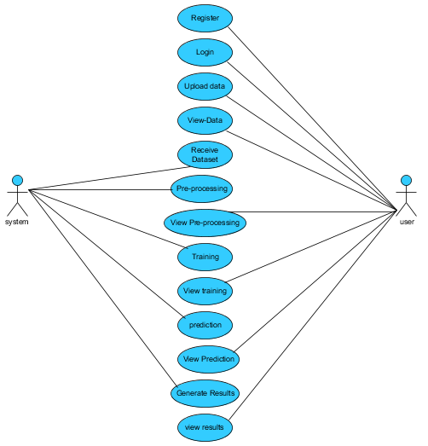
UML DIAGRAMS
USE CASE DIAGRAM

Slide 14
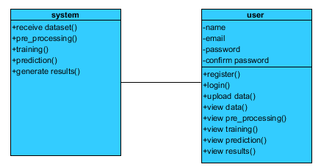
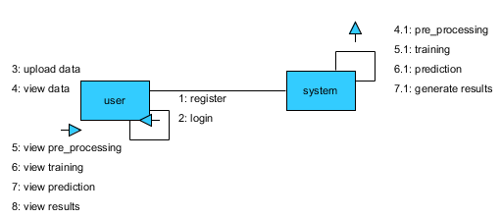
UML DIAGRAM
CLASS DIAGRAM
COLLABORATION DIAGRAM

Slide 15
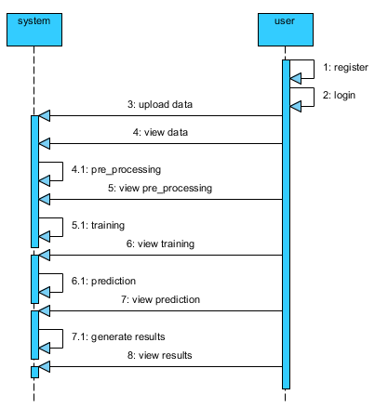
UML DIAGRAM
SEQUENCE DIAGRAM

Slide 16
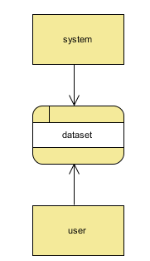
UML DIAGRAM
CONTEXT LEVEL DIAGRAM

Slide 17
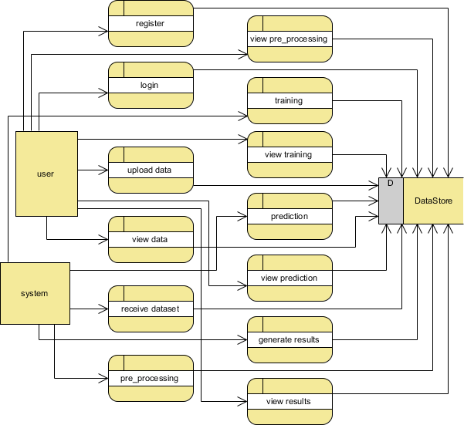
UML DIAGRAM
LEVEL 1:

Slide 18
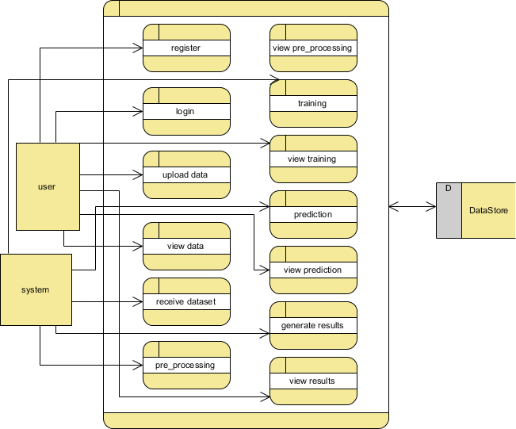
UML DIAGRAM
LEVEL 2:

Slide 19
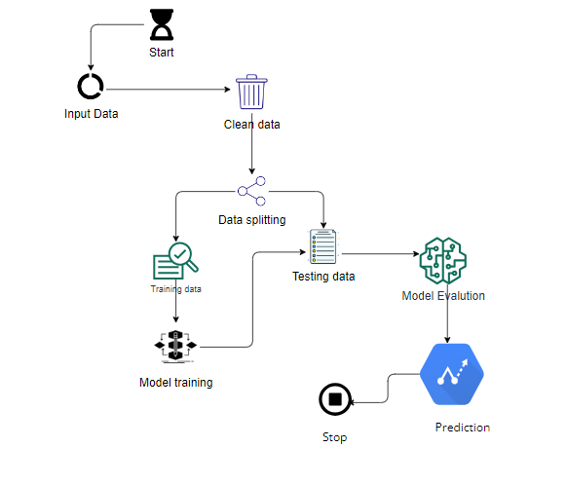

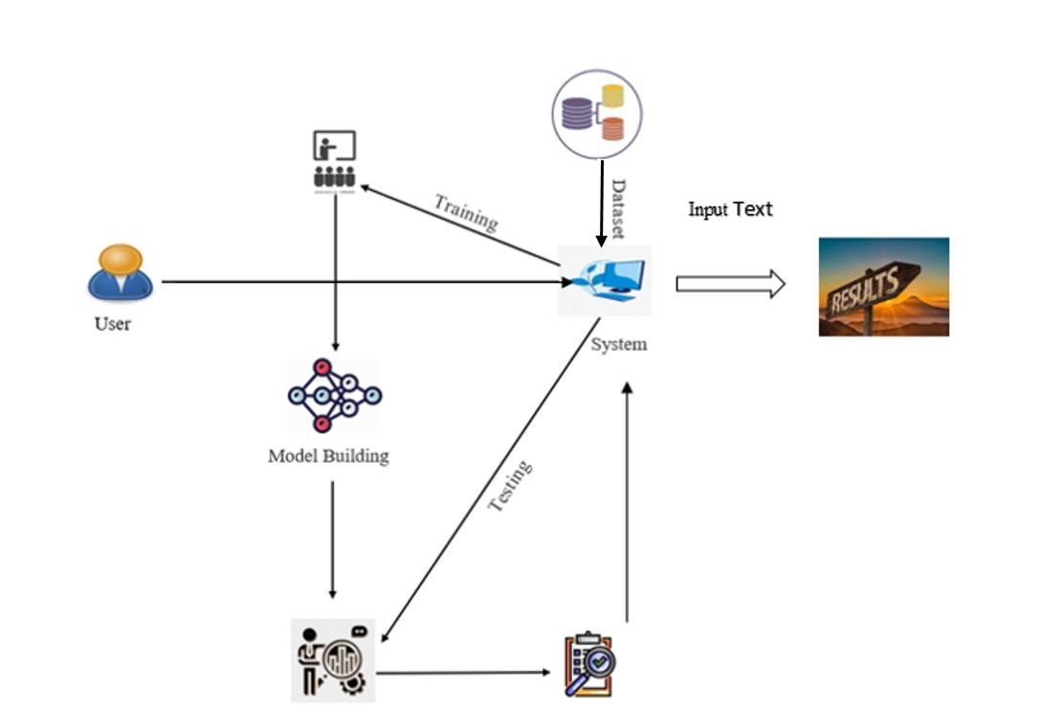
Architecture diagram

Slide 20
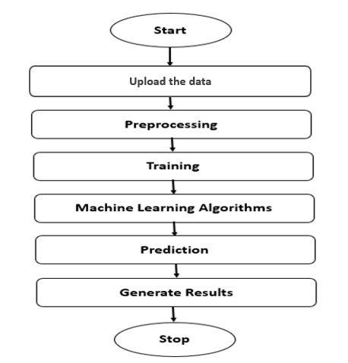
Proposed Modules
Module-1
Upload the data
Module-2
Preprocessing
Module-3
Training
Module-4
Machine learning Algorithms
Module-5
Prediction
Module-6
Generate results
02-09-2022
19

Slide 21
MODULE DESCRIPTION
Understand the principles of cybersecurity, including common threats and vulnerabilities.
Comprehend the basics of machine learning and its relevance to cybersecurity.
Analyze and preprocess cybersecurity data for machine learning applications.
Implement machine learning algorithms for cyber threat prediction and detection.
Evaluate the performance of machine learning models for cybersecurity applications.
Apply feature engineering and data selection techniques in the context of cyber threat prediction.
Develop strategies for handling imbalanced data in cybersecurity.
Understand the ethical and legal considerations in the use of machine learning for cybersecurity.

Slide 22
ALGORITHMS USED FOR TRAINING
Decision Tree
Random Forest Classifier
Support Vector Machine
Cat-Boost

Slide 23
screenshots

Slide 24
REFERENCES
Kwon, Cheolhyeon, Weiyi Liu, and Inseok Hwang. ”Security analysis for cyber-physical systems against stealthy deception attacks.” In 2013 American control conference, IEEE (2013): 3344-3349
Pajic, Miroslav, James Weimer, Nicola Bezzo, Oleg Sokolsky, George J. Pappas, and Insup Lee. ”Design and implementation of attack-resilient cyberphysical systems: With a focus on attack-resilient state estimators.” IEEE Control Systems Magazine 37, no. 2 (2017): 66-81.
Sheng, Long, Ya-Jun Pan, and Xiang Gong. ”Consensus formation control for a class of networked multiple mobile robot systems.” Journal of Control Science and Engineering 2012 (2012).
Zeng, Wente, and Mo-Yuen Chow. ”Resilient distributed control in the presence of misbehaving agents in networked control systems.” IEEE transactions on cybernetics 44, no. 11 (2014): 2038-2049.
Sun, Hongtao, Chen Peng, Taicheng Yang, Hao Zhang, and Wangli He. ”Resilient control of networked control systems with stochastic denial of service attacks.” Neurocomputing 270 (2017): 170-177.

Slide 25
Thank You

